Slide 1




Slide 2







Slide 3









Slide 4
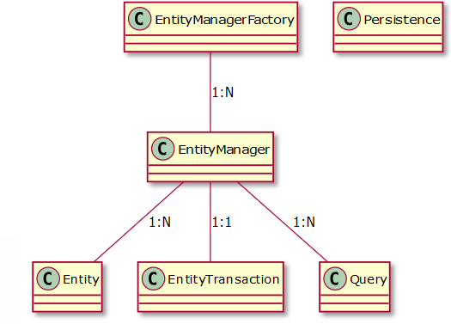

Slide 5







Slide 6






persist()
remove()
merge()
find()
lock()
detach()
refresh()

Slide 7





persist

Slide 8


merge

Slide 9



remove

Slide 10

refresh

Slide 11



commit
flush
commit
flush

Slide 12











Slide 13










Slide 14







Slide 15


Slide 16





-
-
-

Slide 17








